Slide 1
Job Market Analysis and Recommendation System
Name : ashish Pachauri Company : NextHike IT Solution

Slide 2
Objective
Analyze job market trends: Extract meaningful patterns from both historical and current job postings to understand how industries, roles, and skills are shifting over time
Identify high-demand job roles: Detect which job titles and skill sets are most sought after to help candidates focus their efforts where market demand is greatest.
Uncover salary dynamics: Examine correlations between job keywords and offered salaries so users can predict compensation ranges more accurately.
Spot emerging job categories: Use posting frequency and growth analysis to determine which new fields are rising in popularity, helping guide user upskilling and career transitions.
Deliver personalized recommendations: Build an automated engine that matches job seekers to suitable openings, tailored to their skills, interests, and market opportunities in real-time.

Slide 3
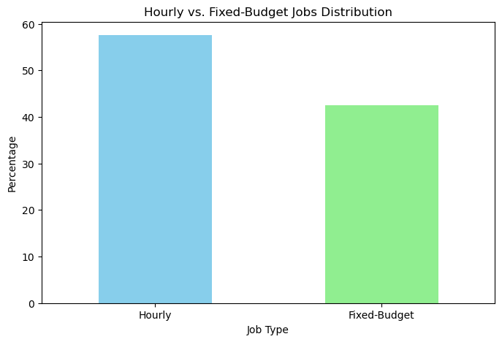
Hourly vs. Fixed-Budget Jobs Distribution
The bar chart titled "Hourly vs. Fixed-Budget Jobs Distribution" illustrates the comparative prevalence of two job types based on percentage. The Hourly jobs, represented by a light blue bar, account for 60% of the total, indicating they are the more dominant format. In contrast, Fixed-Budget jobs, shown in light green, make up 45%, suggesting a smaller share. This visual highlights a clear preference for Hourly jobs in the current job market. The difference of 15 percentage points suggests that employers or platforms may favor time-based compensation. The chart’s simplicity makes it easy to interpret at a glance. It also implies potential trends in freelancing or gig work environments. Understanding this distribution can help job seekers tailor their applications or pricing strategies accordingly.

Slide 4
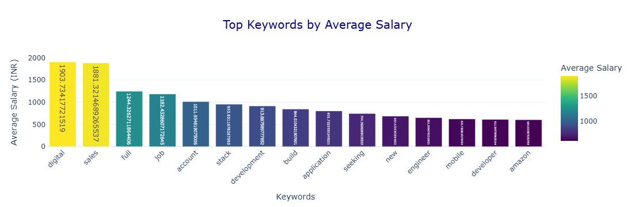
Top Keywords by Average Salary
The bar chart titled "Top Keywords by Average Salary" presents a visual comparison of average salaries (in INR) associated with various job-related keywords. The x-axis lists keywords such as digital, sales, full, job, account, stack, development, build, application, seeking, new, engineer, mobile, developer, and amazon. The y-axis quantifies their corresponding average salaries. A color gradient from purple to yellow is used, where yellow indicates higher salaries and purple denotes lower ones. Notably, "digital" and "sales" stand out with the highest average salaries of ₹1903.3 and ₹1881.3, respectively. This suggests that roles involving digital skills and sales expertise are currently in high demand and command premium pay. Other keywords like "developer" and "engineer" also show competitive salary figures, reflecting the value of technical roles. The chart provides useful insights for job seekers aiming to align their skills with high-paying opportunities.

Slide 5
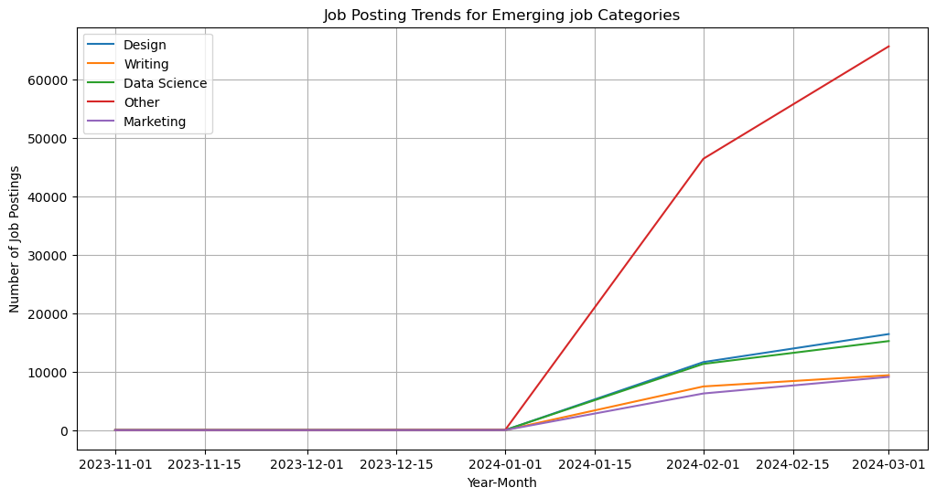
Job Posting Trends for Emerging job Categories
All categories had zero job postings until around January 2024.
A sharp rise in postings began after 2024-01-01, indicating a sudden market shift.
The "Other" category saw the highest surge, reaching over 60,000 postings by March 2024.
Data Science followed with a strong increase, hitting around 30,000 postings.
Design and Marketing grew moderately, both reaching about 10,000 postings.
Writing showed the least growth, staying just below 10,000 postings.
The graph highlights rapid expansion in certain fields, especially non-traditional or miscellaneous roles.

Slide 6
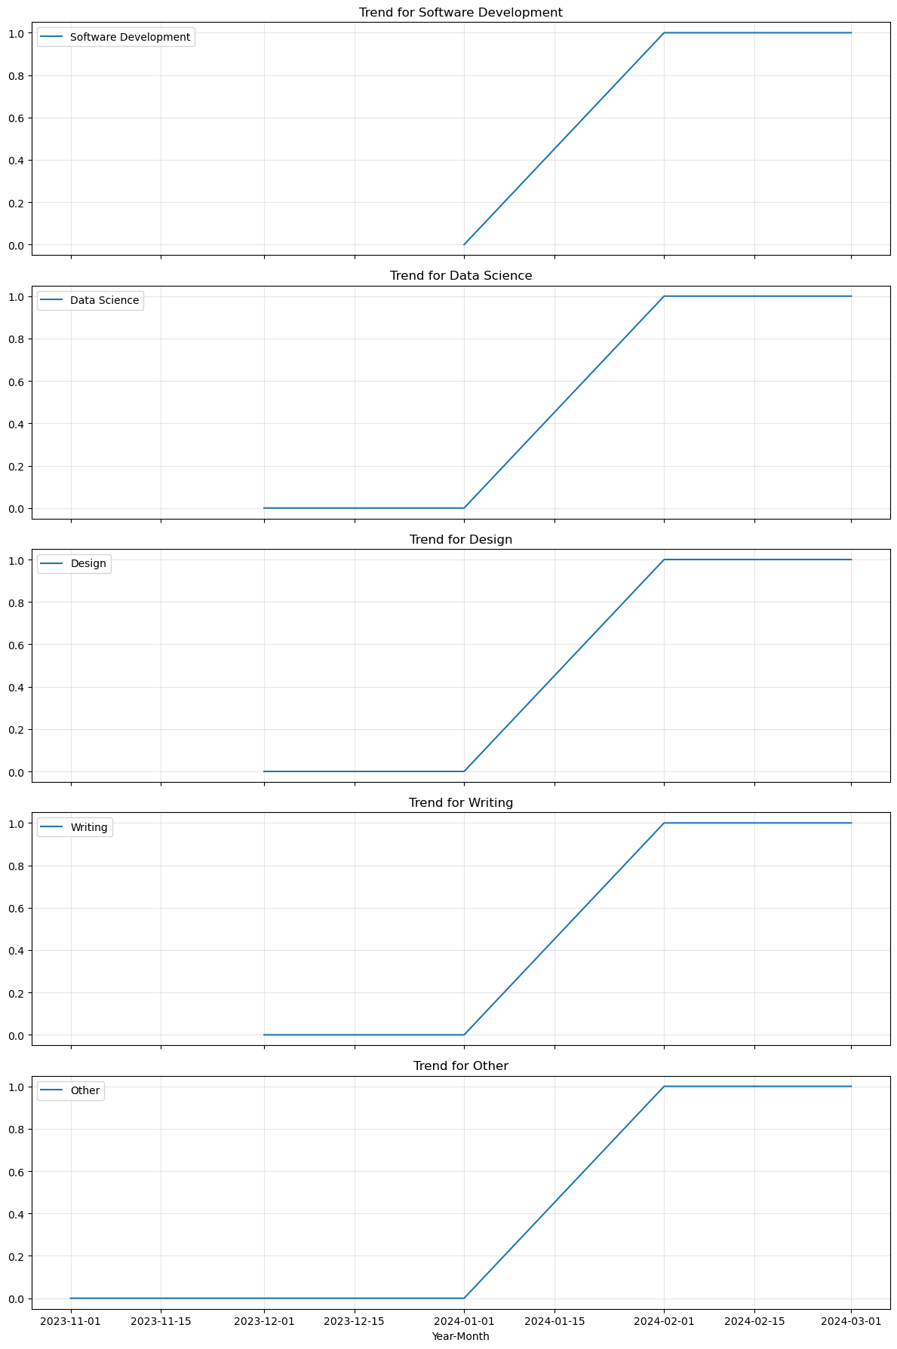
📈 Software Development, Data Science, Design, and Writing all show identical patterns: starting at 0.0 in November and rising sharply to 1.0 by January 1, 2024, then plateauing.
📊 This suggests a rapid surge in interest or activity in these fields during the final months of 2023.
🟥 The "Other" category follows a similar trajectory but reaches its peak one month later, by February 1, 2024.
⏳ Once each field hits the peak value of 1.0, the trend remains stable, indicating sustained momentum.
🔍 The uniformity across most graphs implies a coordinated or market-wide shift in job demand or postings.
📅 The time-based x-axis helps visualize how quickly these fields gained traction.
📌 The delayed rise in the "Other" category may reflect emerging or niche roles gaining recognition slightly later.
🚀 Overall, the graphs highlight a strong upward trend in job activity across multiple domains within a short span.
💡This visualization is useful for identifying timing and consistency in job market growth across sectors.

Slide 7
Compare average hourly rates across different countries
Top 10 countries with highest wages:
Bottom 10 countries with lowest wages:
country | average_hourly_rate
Laos | 155.125000
Eritrea | 61.250000
Turks and Caicos Islands | 46.625000
Malawi | 42.375000
Netherlands Antilles | 35.416667
Liechtenstein | 35.000000
French Guiana | 34.000000
Malaysia | 31.661130
Thailand | 30.319061
British Virgin Islands | 29.145833
country | average_hourly_rate
French Polynesia | 19.029412
United States Minor Outlying Islands | 18.750000
Guadeloupe | 18.428571
Holy See | 17.500000
Aruba | 17.263158
Niger | 16.500000
Brunei Darussalam | 15.875000
Fiji | 15.833333
Vanuatu | 6.500000
Central African Republic | 5.000000

Slide 8
Create a job recommendation engine based on current job postings
Top 10 Job Recommendations
title | country | similarity_score
data scientist | United States | 1.000000
data scientist | United States | 1.000000
data scientist | United States | 1.000000
data scientist | United States | 1.000000
data scientist | United States | 1.000000
data scientist | United States | 1.000000
data scientist | United States | 0.969321
data scientist | United States | 0.969321
data scientist | United States | 0.969321
data scientist | United Kingdom | 0.920596
This table presents the top 10 job recommendations for the role of Data Scientist, ranked by similarity score. The highest-ranking six positions, all based in the United States, have a perfect similarity score of 1.000000, indicating an exact match with the candidate’s profile or preferences. The next three roles, also in the U.S., have slightly lower scores of 0.969321, still reflecting a strong alignment. The tenth recommendation is located in the United Kingdom, with a score of 0.920596, suggesting a good but slightly less precise match. Overall, the table emphasizes a strong demand for data scientists in the U.S. market, with multiple roles offering near-perfect compatibility. This could be a valuable guide for prioritizing applications or exploring relocation opportunities.

Slide 9
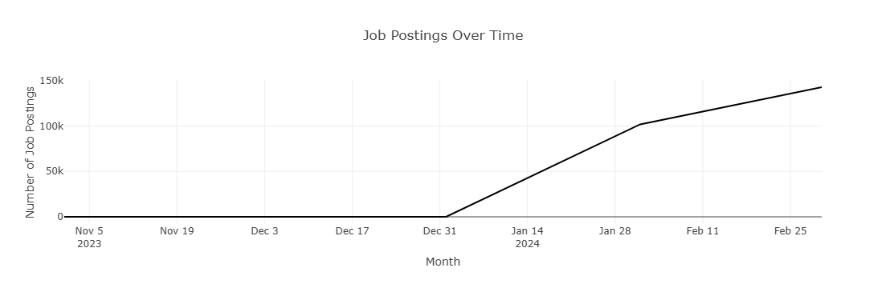
Job Postings Over Time
The graph titled "Job Postings Over Time" shows how the number of job postings changed from November 5, 2023, to February 25, 2024. From early November to the end of December, the number of postings remained flat, indicating no growth during that period. On December 31, there was a sudden and sharp increase in job postings. This upward trend continued rapidly through mid-January and then grew more gradually until the end of February. By February 25, the number of job postings reached close to 150,000. The graph suggests that hiring activity picked up significantly after the New Year, possibly due to companies starting new projects or budgets. This pattern highlights early January as a strong time for job seekers to apply.

Slide 10
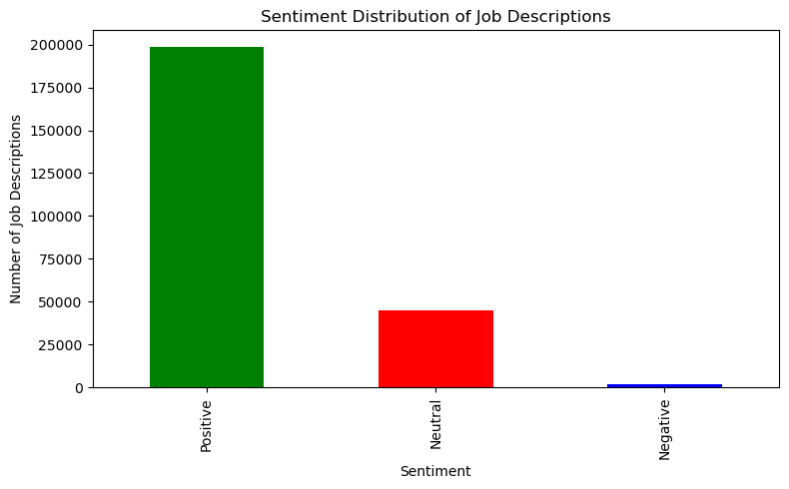
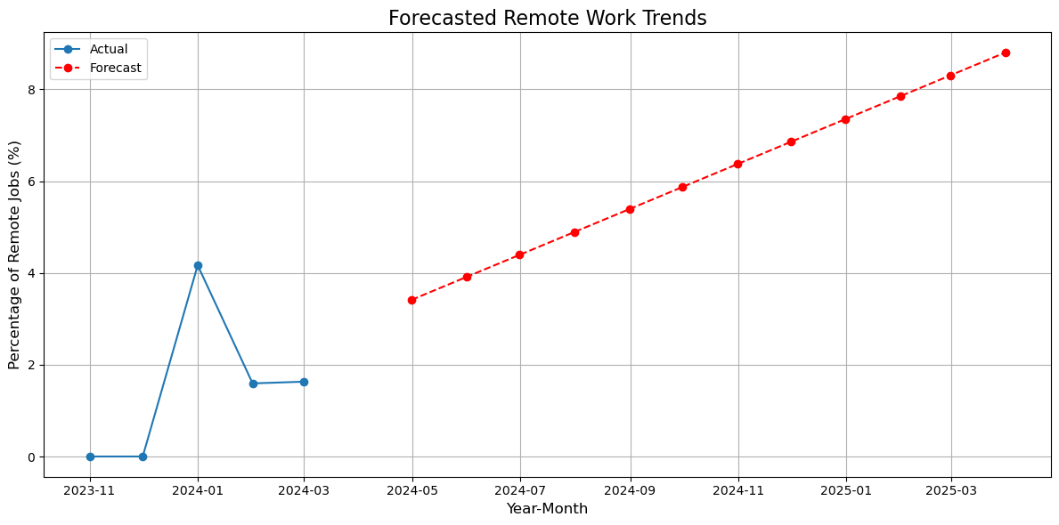
Investigate trends in the remote work landscape
This bar chart titled "Sentiment Distribution of Job Descriptions" reveals how job postings are emotionally framed. The majority of descriptions fall under the Positive category, with nearly 200,000 entries, suggesting that employers tend to use encouraging and optimistic language to attract candidates. The Neutral sentiment comes next, with around 50,000 descriptions, indicating a more factual or balanced tone. The Negative sentiment is minimal—under 10,000 descriptions—showing that very few job postings use discouraging or critical language. Overall, the graph highlights a clear preference for positivity in job descriptions, which likely helps create a more appealing and welcoming impression for job seekers.
This line graph titled "Forecasted Remote Work Trends" illustrates both historical and predicted changes in the percentage of remote jobs from March 2023 to March 2025. The blue line, representing actual data, shows a noticeable peak in April 2023, followed by a decline in May 2023. From that point onward, the red dashed line forecasts a steady upward trend, suggesting that remote work is expected to grow consistently over the next two years. This gradual increase reflects a broader shift in workplace dynamics, with more companies likely embracing flexible work arrangements. The forecasted rise may be driven by evolving employee preferences, technological advancements, and cost-saving strategies.

Slide 11
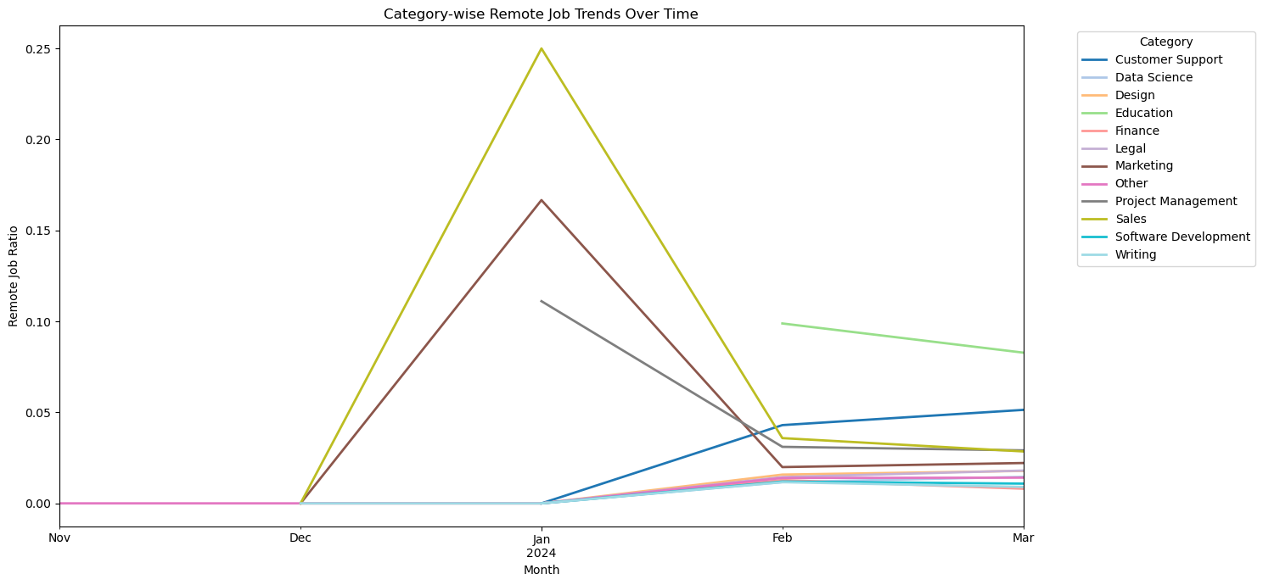
Category-wise Remote Job Trends Over Time
Remote Job Trends by Category¶
Sales and Finance categories saw a dramatic surge in remote job ratios in Jan 2024, peaking above all other categories.
Both categories experienced a steep drop in remote job ratios by Feb 2024, suggesting either a return to hybrid/in-office roles or short-term remote contracts.
Education showed a gradual upward trend, indicating growing acceptance of remote teaching and learning roles.
Customer Support, Software Development, and Writing maintained consistent remote ratios, reinforcing their suitability for remote work.
Legal, Marketing, and Design had minimal remote ratio changes, possibly due to role-specific collaboration needs or slower remote adoption.
Project Management & Other Roles: These categories showed moderate fluctuations, hinting at evolving remote policies or project-based flexibility.

Slide 12
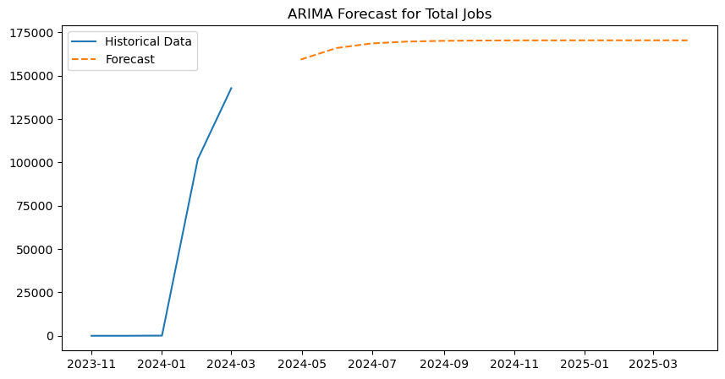
Predict future job market trends
This line chart titled "ARIMA Forecast for Total Jobs" presents both historical and projected job growth from November 2023 to March 2025. The solid blue line shows a dramatic rise in total jobs starting in late 2023, reaching over 150,000 by early 2024. From there, the dashed orange line, representing the ARIMA forecast, predicts a continued upward trend, gradually leveling off just below 175,000 by mid-2025. This suggests sustained growth in the job market, though the pace may slow slightly over time. The use of ARIMA modeling adds statistical rigor to the forecast, making it a valuable tool for workforce planning and economic analysis. Overall, the chart reflects a strong recovery and optimistic outlook for employment opportunities in the coming year.

Slide 13
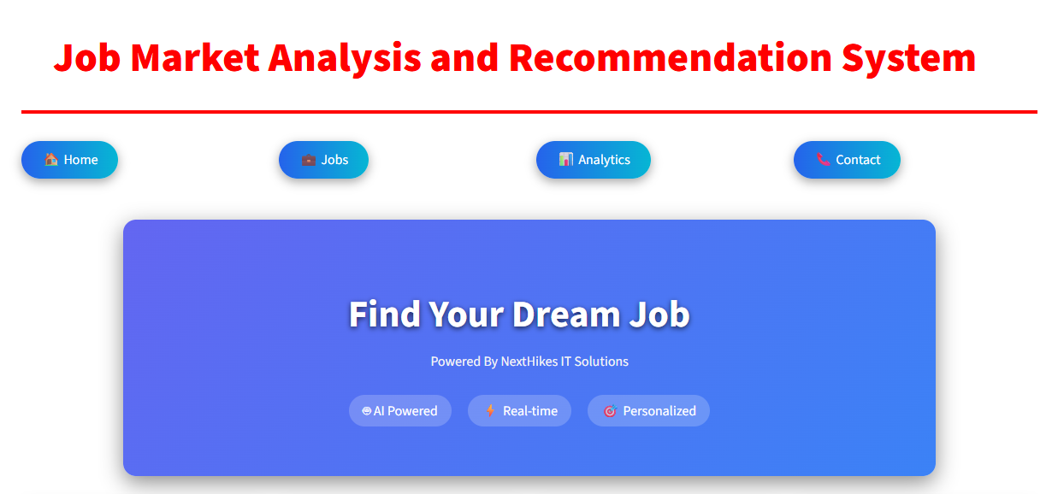
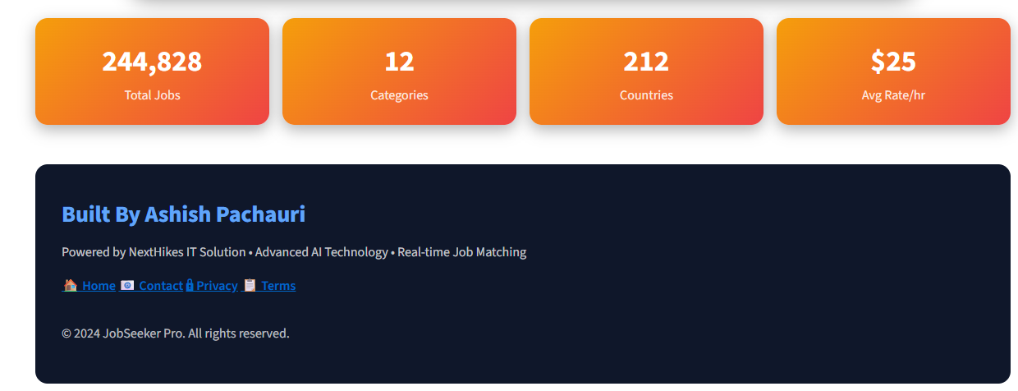
STREAMLIT DASH-BOARD
The first image presents key statistics from the job listing platform. It highlights the platform’s scale and global reach, with 244,828 total jobs spread across 12 categories and 212 countries. There are 4 buttons which use for operate and can function it.
The second image displays the main interface of the Job Market Analysis and Recommendation System. It features a bold title and a clean navigation bar with buttons for Home, Jobs, Analytics, and Contact. The central call-to-action, "Find Your Dream Job", is prominently placed within a blue gradient box, reinforcing the platform’s mission.

Slide 14
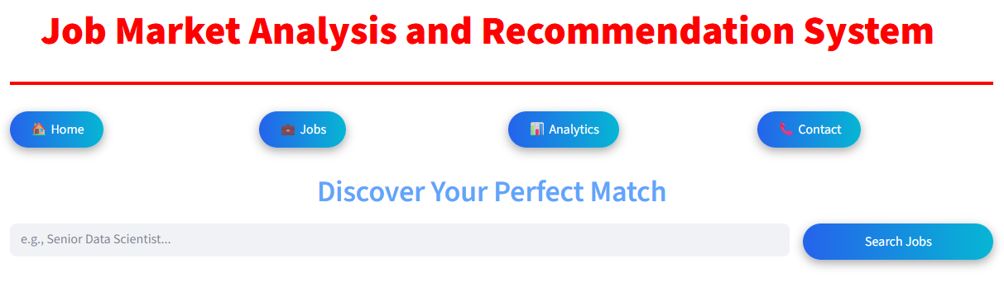
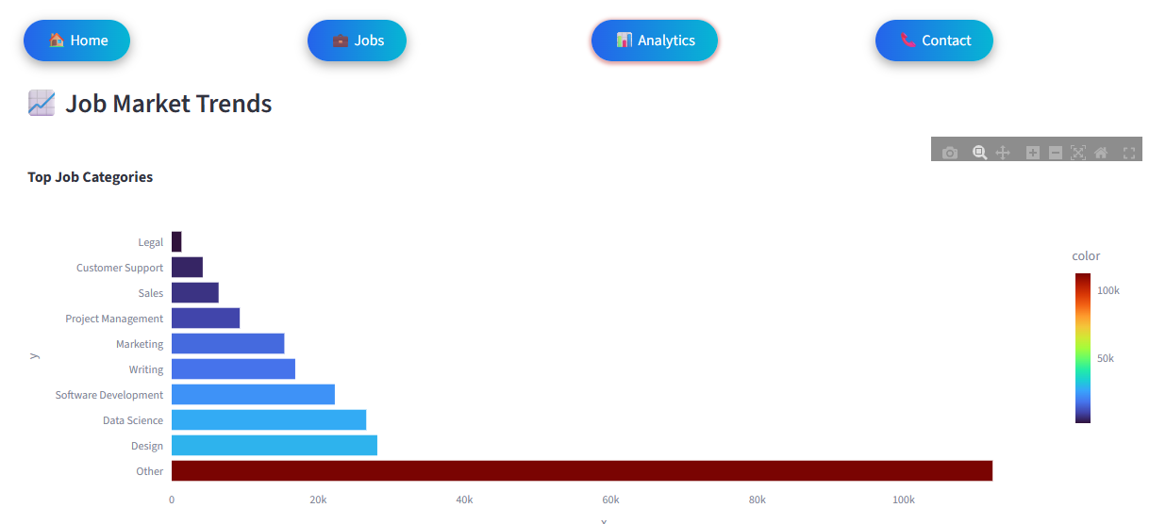
The first image highlights job market demand across categories, showing "Other" as the most dominant with over 100k listings, while Legal and Customer Support trail behind. The vibrant color gradient and horizontal bars make it easy to compare sector-wise opportunities. When we click on JOB button then at a time this given window will open.
The second image showcases a sleek interface for a job recommendation system, featuring intuitive navigation and a search bar that invites users to explore roles like "Senior Data Scientist." Its tagline, "Discover Your Perfect Match," emphasizes personalized job discovery powered by smart technology.

Slide 15

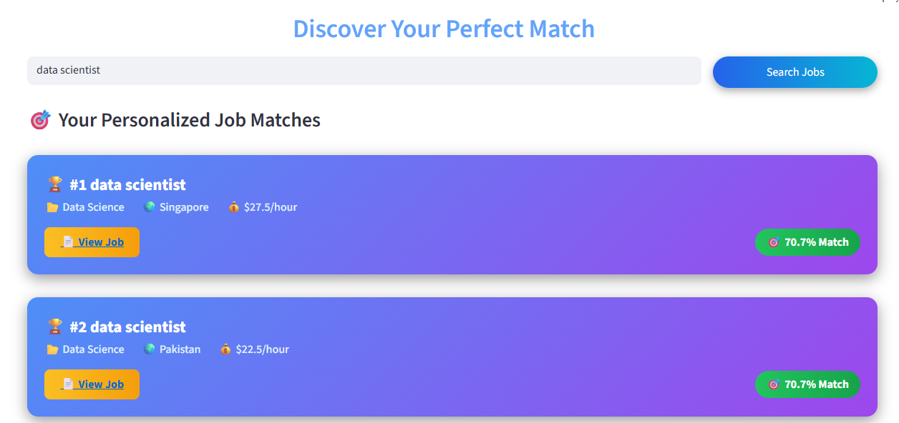
The layout is visually clean and uses icons for each contact method, making it easy to identify and access the information. It’s designed for users who want to connect with the company—whether for job applications, business inquiries, or support.
This image displays a clean and professional job search interface with four navigation buttons at the top:
Home – Likely redirects users to the main landing page of the platform.
Jobs – Opens the section where users can browse or search for available job listings.
Analytics – Provides insights and visualizations about job market trends, demand, and salary data.

Slide 16
Conclusion & Key Insights
The Job Market Analysis and Recommendation System delivers a powerful, data-driven perspective on the rapidly shifting landscape of global employment. By integrating real-time and historical job data, advanced analytics, and intuitive visualization, this system enables both job seekers and employers to make highly informed decisions.
Hourly jobs dominate the current market (60% vs 45% for fixed-budget), indicating a growing preference for flexible, outcome-based work structures, especially in the freelance and gig economies.
"Digital" and "Sales" roles offer the highest average salaries among job-related keywords, underscoring the premium value of digital expertise and sales acumen in today’s market.
Emerging job categories such as Data Science, Design, and Marketing have seen sharp upticks in postings since early 2024, reflecting evolving market needs and the accelerated adoption of tech-enabled roles.
Geographical wage disparities are pronounced, with countries like Laos and Eritrea at the top for hourly rates, while others such as the Central African Republic remain at the lower end, highlighting crucial considerations for global job seekers and remote talent sourcing.
The job recommendation engine effectively matches users to high-suitability roles—especially "Data Scientist" in the U.S.—illustrating the system’s potential to streamline both application and recruitment processes.
Hiring activity surged dramatically after New Year, with job postings nearly reaching 150,000 by February, suggesting cyclic opportunities in the post-holiday job market.
Remote work continues its steady upward trend as forecasted, supported by overwhelmingly positive job description sentiment. Key sectors like Sales, Finance, and Education have shown notable shifts in remote job ratios, reaffirming the market’s pivot to more flexible arrangements.

Slide 17
THANK YOU

